Slide 1
Agenda
Classification Models - Decision Tree
Ensemble Methods
Classification Models - Random Forest
Classification Models - Ensemble Methods (XGBoost)
Implementation with Sklearn
1

Slide 2
1. Classification Models - Decision Tree
2

Slide 3
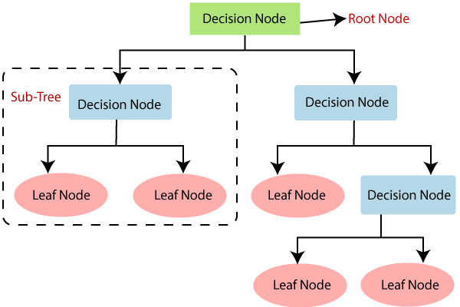
Decision Tree Classification Algorithm:
It is a tree-structured classifier, where internal nodes represent the features of a dataset, branches represent the decision rules and each leaf node represents the outcome.
3

Slide 4
Decision Tree Classification Algorithm:
In a Decision Tree, there are two nodes, which are the Decision
Node and Leaf Node.
Decision nodes are used to make any decision and have multiple branches, whereas Leaf nodes are the output of those decisions and do not contain any further branches.
The decisions or the test are performed on the basis of features of the given dataset.
It is a graphical representation for getting all the possible solutions to a problem/decision based on given conditions.
In order to build a tree, we use the CART algorithm, which stands for Classification and Regression Tree algorithm.
4

Slide 5
Decision Tree Terminologies:
Root Node: Root node is from where the decision tree starts. It represents the entire dataset, which further gets divided into two or more homogeneous sets.
Leaf Node: Leaf nodes are the final output node, and the tree cannot be
segregated further after getting a leaf node.
Splitting: Splitting is the process of dividing the decision node/root node into sub-nodes according to the given conditions.
Branch/Sub Tree: A tree formed by splitting the tree.
Parent/Child Node: The root node of the tree is called the parent node, and other nodes are called the child nodes.
5

Slide 6
How Does the Decision Tree Algorithm Work?
Step-1: Begin the tree with the root node, says S, which contains the
complete dataset.
Step-2: Find the best attribute in the dataset using Attribute Selection Measure (ASM).
Step-3: Divide the S into subsets that contains possible values for the best
attributes.
Step-4: Generate the decision tree node, which contains the best attribute.
Step-5: Recursively make new decision trees using the subsets of the dataset created in step-3. Continue this process until a stage is reached where you cannot further classify the nodes and called the final node as a leaf node.
6

Slide 7
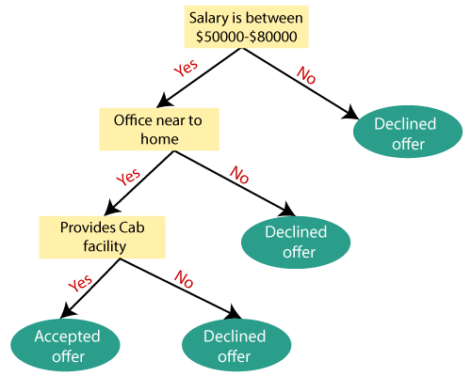
Example:
7

Slide 8
Example:
Suppose there is a candidate who has a job offer and wants to decide
whether he should accept the offer or Not.
So, to solve this problem, the decision tree starts with the root node (Salary attribute by ASM).
The root node splits further into the next decision node (distance from the office) and one leaf node based on the corresponding labels.
The next decision node further gets split into one decision node (Cab facility) and one leaf node.
Finally, the decision node splits into two leaf nodes (Accepted offers and Declined offer).
8

Slide 9
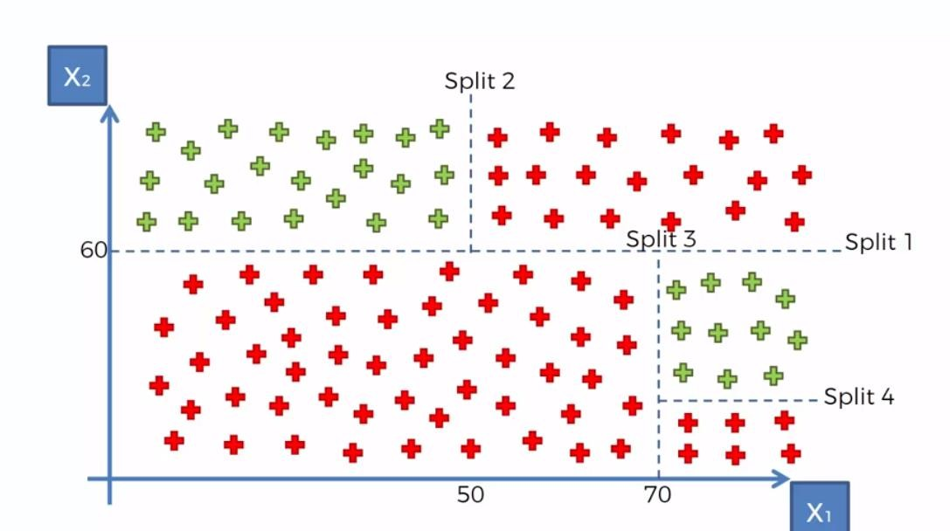
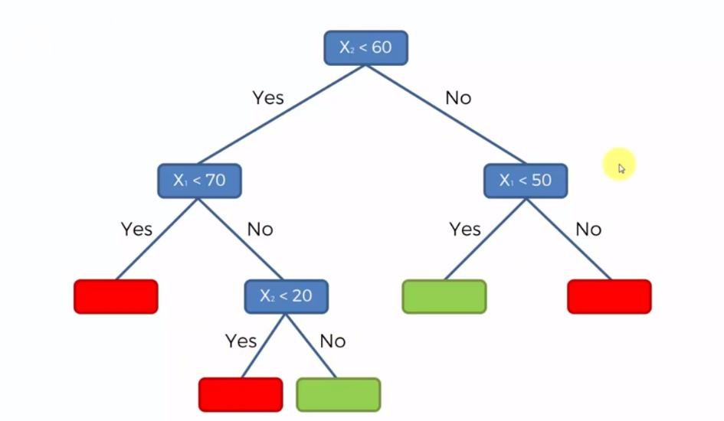
Example:

Slide 10
Attribute Selection Measures:
While implementing a Decision tree, the main issue arises that how to
select the best attribute for the root node and for sub-nodes.
So, to solve such problems there is a technique which is called as Attribute selection measure ( ASM ).
By this measurement, we can easily select the best attribute for the nodes
of the tree.
There are two popular techniques for ASM, which are:
Information Gain
Gini Index

Slide 11
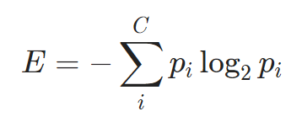
Information Gain:
Information Gain: It is a metric used to train Decision Trees. Specifically,
this metric measure the quality of a split.
Entropy: It is a metric to measure the impurity in a given attribute. It specifies randomness in data.
Entropy = - [P(yes) log2 P(yes) + P(no) log2 P(no)]
Where ”P” is the probability of randomly picking an element of class i (i.e. the
proportion of the dataset made up of class i)

Slide 12
Information Gain:
Information Gain is the measurement of changes in entropy after the
segmentation of a dataset based on an attribute.
It calculates how much information a feature provides us about a class.
According to the value of information gain, we split the node and build the
decision tree.
A decision tree algorithm always tries to maximize the value of information gain, and a node/attribute having the highest information gain is split first.
Information Gain = Entropy(data) - [(Weighted Avg) * Entropy(each feature)]

Slide 13
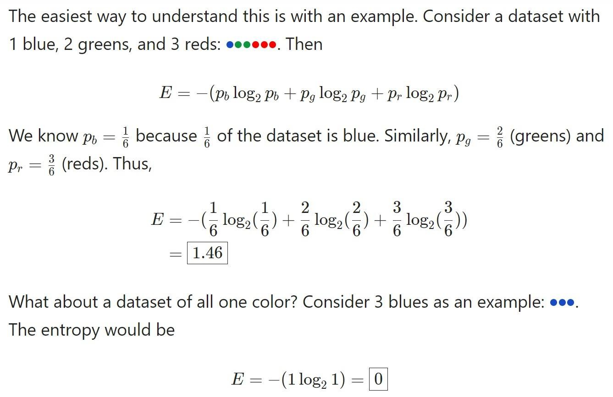
Information Gain - Entropy Example:

Slide 14
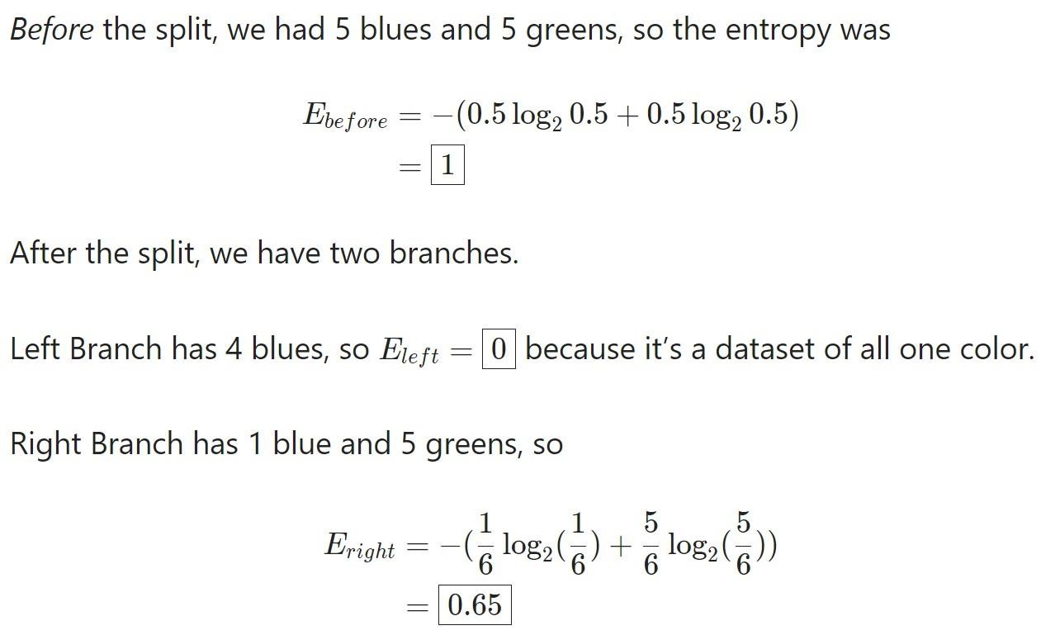
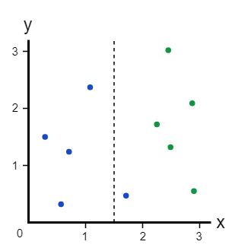
Information Gain - Complete Example:

Slide 15
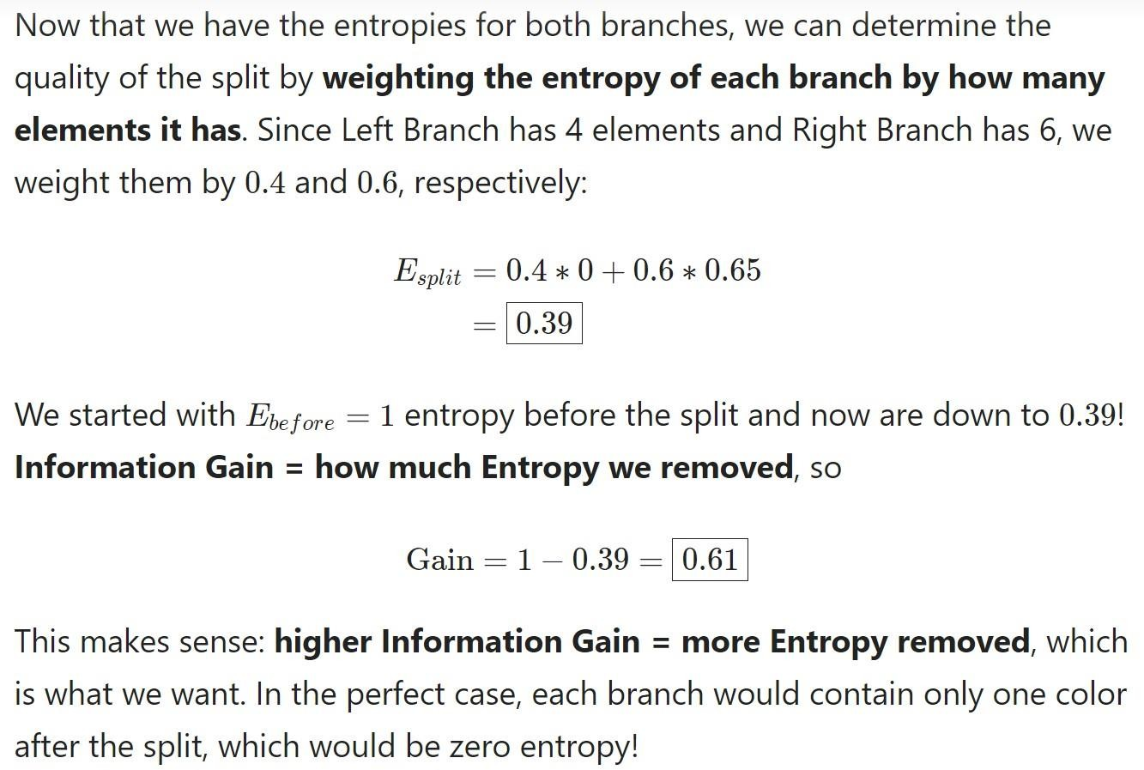
Information Gain - Complete Example:

Slide 16
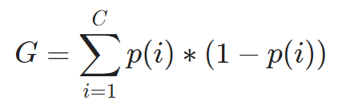
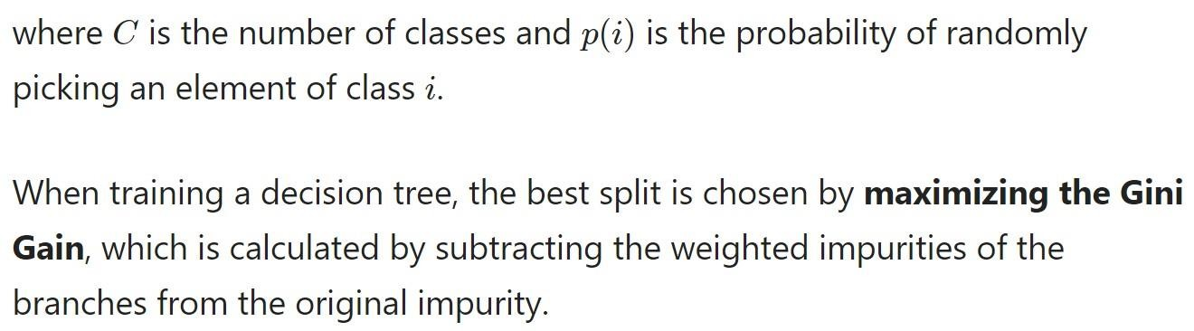
Gini Index/Impurity:
Gini Impurity: It is the probability of incorrectly classifying a randomly chosen element in the dataset if it was randomly labelled according to the class distribution in the dataset.

Slide 17
Gini Index/Impurity:
Gini Index is a measure of impurity used while creating a decision tree in
the CART algorithm.
An attribute with the low Gini Index should be preferred as compared to the high Gini Index.
It only creates binary splits, and the CART algorithm uses the Gini Index to
create binary splits.

Slide 18
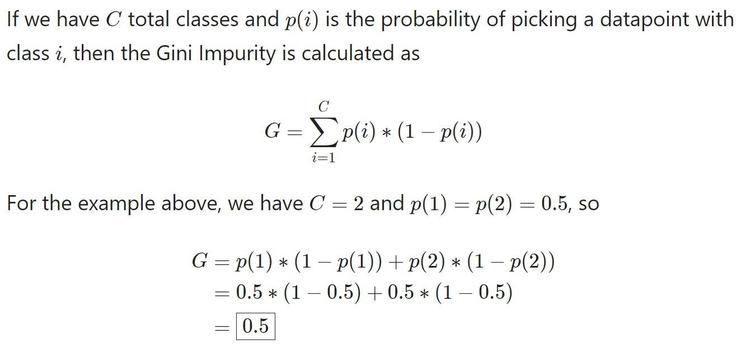
Gini Index - Complete Example:

Slide 19
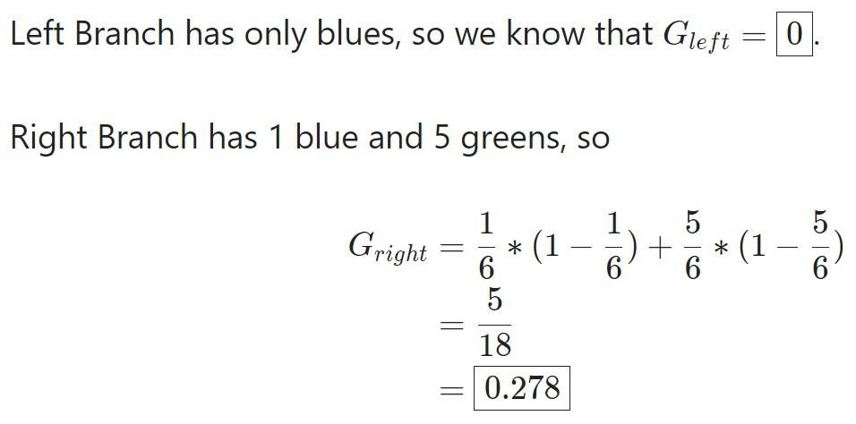
Gini Index - Complete Example:

Slide 20
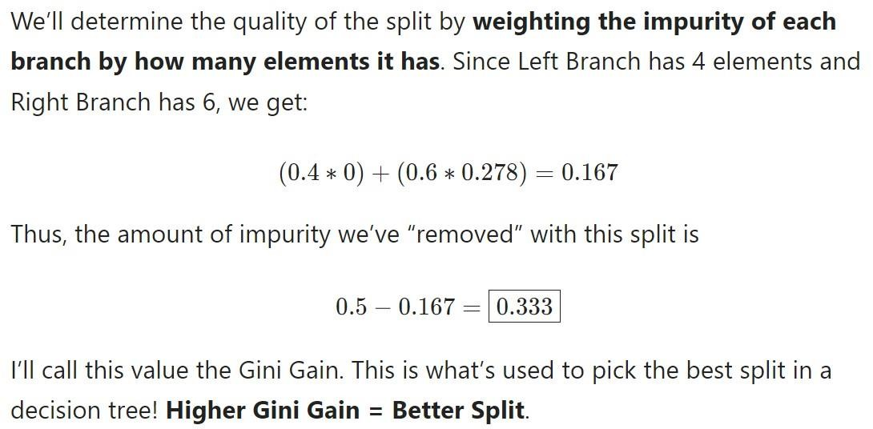
Gini Index - Complete Example:

Slide 21
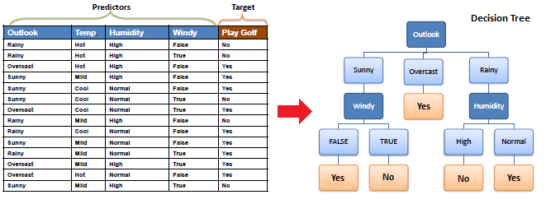
Decision Tree ID3 Algorithm

Slide 22
Decision Tree ID3 Algorithm
Build Decision Tree Steps USING ID3 Algorithm :
Step 1: Calculate entropy of the target Label .
Step 2: The dataset is then split on the different attributes. Calculate entropy and information gain for each attributes (Column)
Step 3: Choose attribute with the largest information gain as the decision node, divide
the dataset by its branches and repeat the same process on every branch
Step 4: A branch with entropy of 0 is a leaf node. And A branch with entropy more than 0
needs further splitting
Step 5: The ID3 algorithm is run recursively on the non-leaf branches, until all data is
23classified

Slide 23
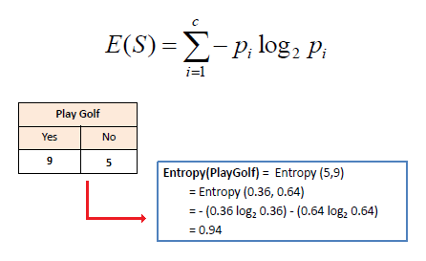
Decision Tree ID3 Algorithm
Step 1: Calculate entropy of the target Label .

Slide 24
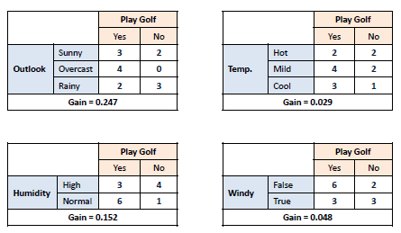
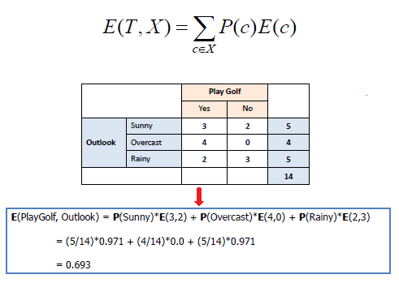
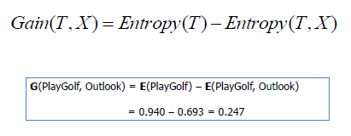
Decision Tree ID3 Algorithm
Step 2: The dataset is then split on the different attributes. Calculate entropy and
information gain for each attributes (Column)

Slide 25
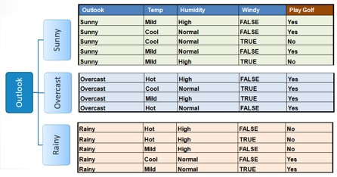
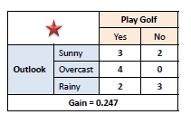
Decision Tree ID3 Algorithm
Step 3: Choose attribute with the largest information gain as the decision node, divide the
dataset by its branches and repeat the same process on every branch

Slide 26
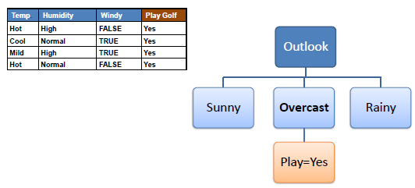
Decision Tree ID3 Algorithm
Step 4a: A branch with entropy of 0 is a leaf node.

Slide 27
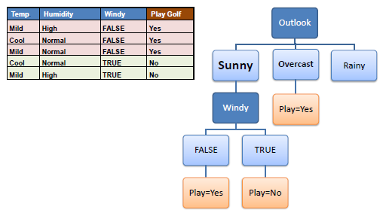
Decision Tree ID3 Algorithm
Step 4b: A branch with entropy more than 0 needs further splitting.

Slide 28
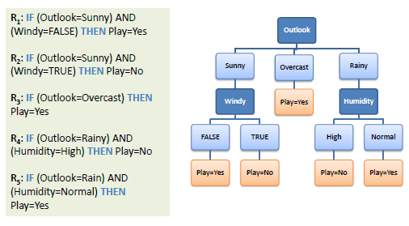
Decision Tree ID3 Algorithm
Step 5: The ID3 algorithm is run recursively on the non-leaf branches, until all data is
classified

Slide 29
Advantages of the Decision Tree:
It is simple to understand as it follows the same process which a human
follow while making any decision in real-life.
It can be very useful for solving decision-related problems.
It helps to think about all the possible outcomes for a problem.
There is less requirement of data cleaning compared to other
algorithms.

Slide 30
Disadvantages of the Decision Tree:
The decision tree contains lots of layers, which makes it complex.
It may have an overfitting issue, which can be resolved using the Random Forest algorithm.
For more class labels, the computational complexity of the decision tree
may increase.

Slide 31
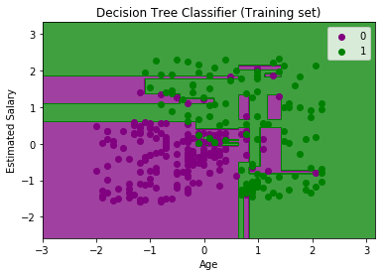
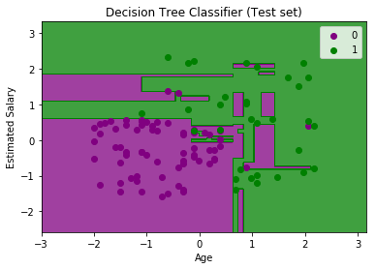
Sklearn Decision Tree:
The output is completely different from the rest classification models. It has both vertical and horizontal lines that are splitting the dataset according to the age and estimated salary variables.

Slide 32
2. Ensemble Methods

Slide 33
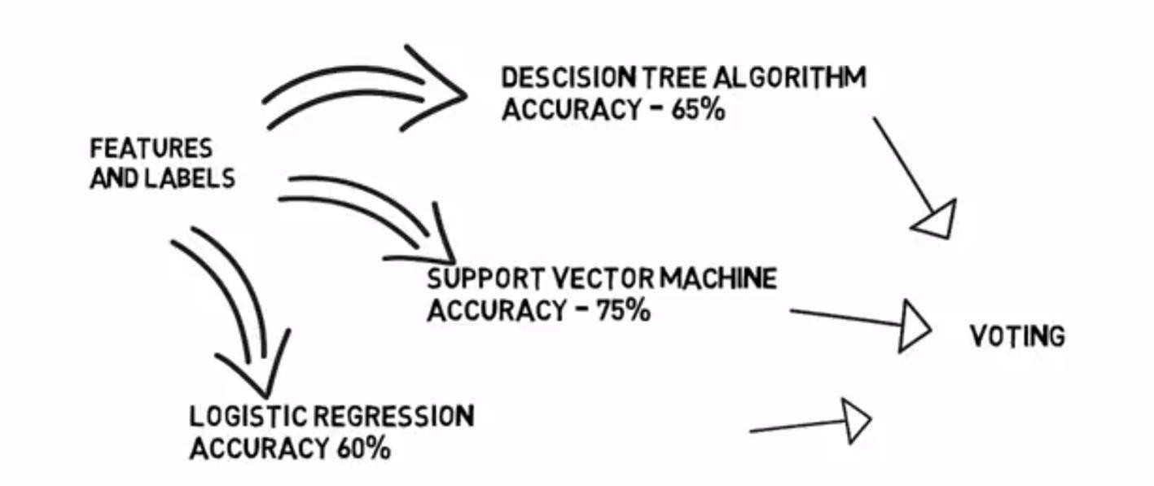
Ensemble Learning:
Using multiple learning algorithms together for the same task.
Better predictions than individual learning algorithms.

Slide 34
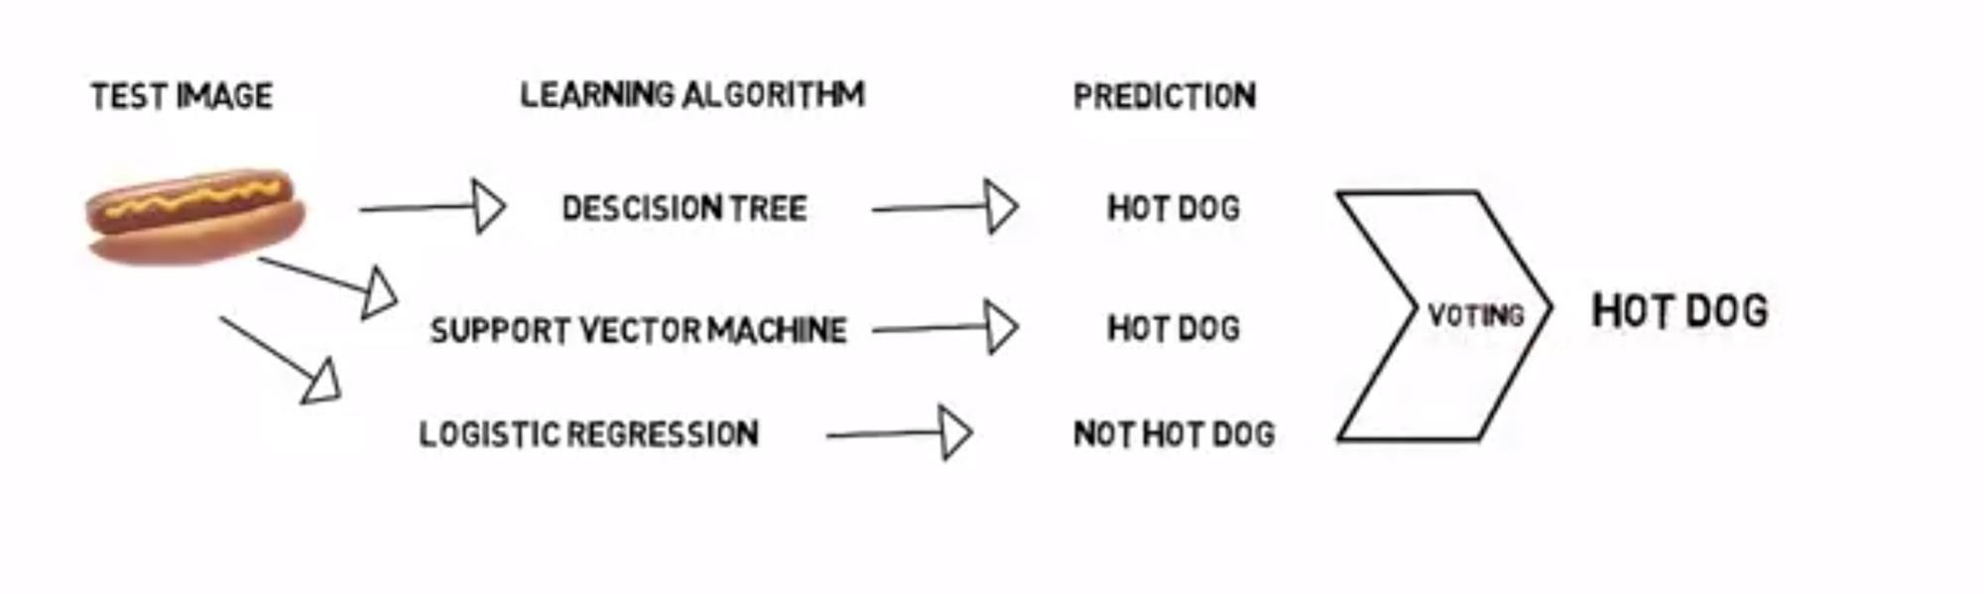
Ensemble Learning:

Slide 35
Ensemble Learning:
Why use Ensemble Methods?
Better accuracy (lower error).
Higher consistency (avoid over fitting).
Reduce bias and variance errors.
When and Where to use Ensemble Methods?
Single model over fits.
Results worth the extra training.
Can be used for classification and regression.

Slide 36
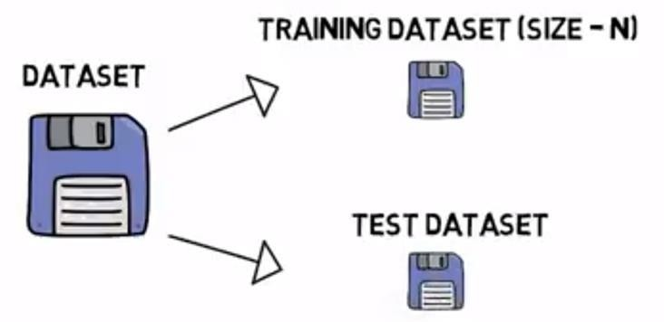
Bootstrap Aggregating (Bagging):
Multiple models of same learning algorithm trained with subsets of
dataset randomly picked from the training dataset.

Slide 37
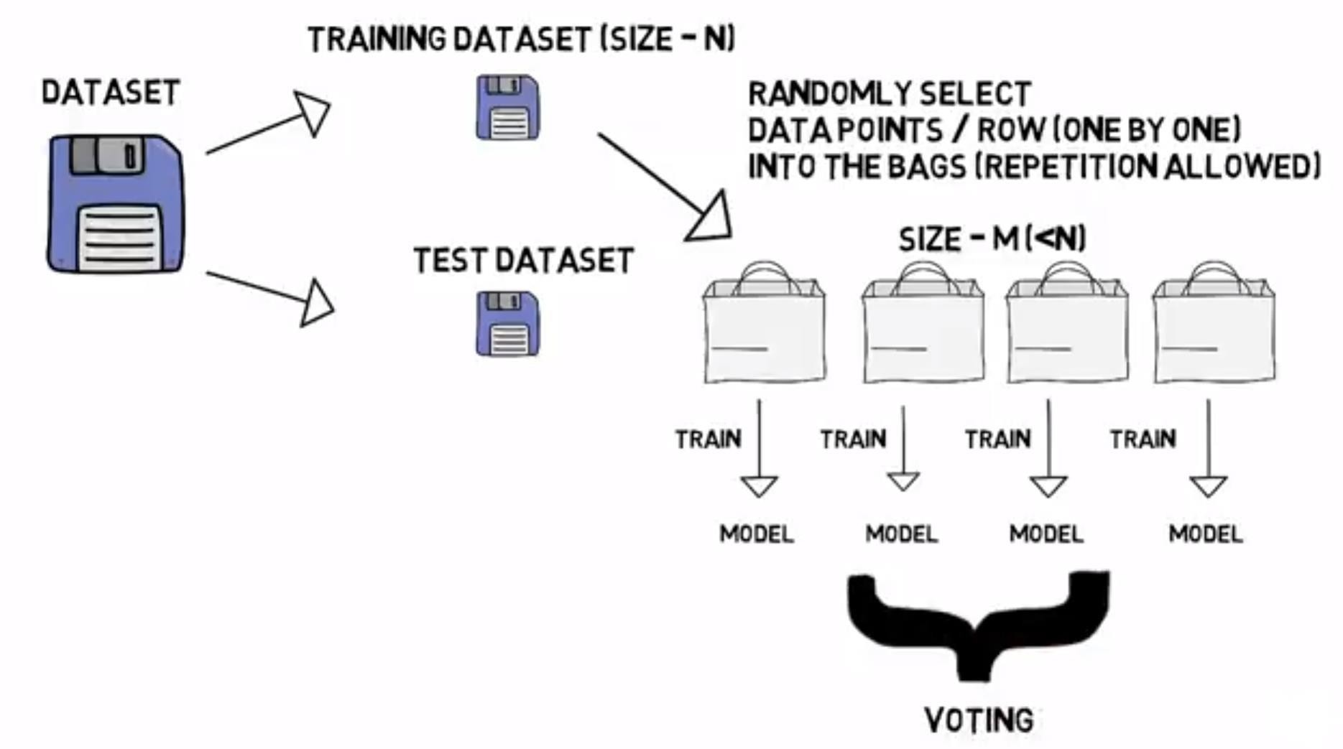
Bootstrap Aggregating (Bagging):

Slide 38
Boosting:
Little variation on Bagging.
Selecting points which give wrong predictions.

Slide 39
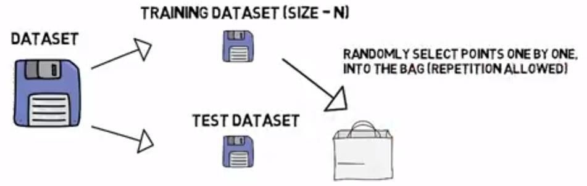
Boosting:

Slide 40
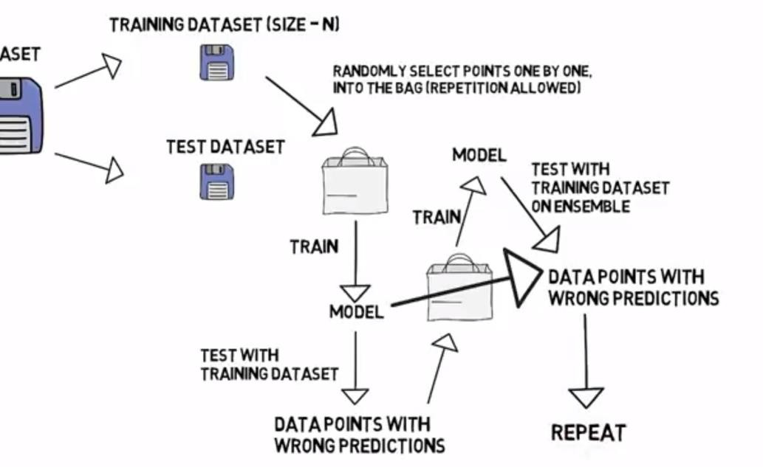
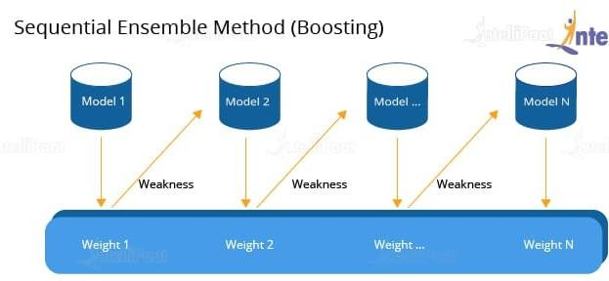
Boosting:

Slide 41
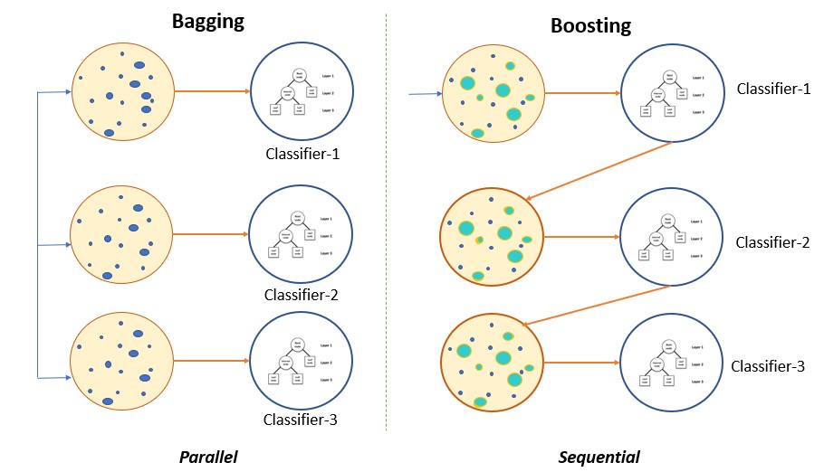
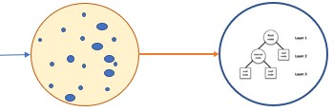
Ensemble:
single
41

Slide 42
3. Classification Models - Random Forest
42

Slide 43
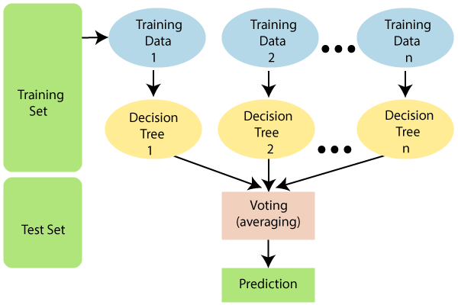
Random Forest Classification Algorithm:
Random Forest is a classifier that contains a number of decision trees on various subsets of the given dataset and takes the average to improve the predictive accuracy of that dataset.
43

Slide 44
Random Forest Classification Algorithm:
Instead of relying on one decision tree, the random forest takes the prediction from each tree and based on the majority votes of predictions, it predicts the final output.
The greater number of trees in the forest leads to higher accuracy and prevents the problem of overfitting.
44

Slide 45
How Does the Random Forest Algorithm Work?
Random Forest works in two-phase:
First is to create the random forest by combining N decision tree.
And second is to make predictions for each tree created in the first phase.
The Working process can be explained in the below steps:
Step-1: Select random K data points from the training set.
Step-2: Build the decision trees associated with the selected data points.
Step-3: Choose the number N for decision trees that you want to build.
Step-4: Repeat Step 1 & 2.
Step-5: For new data points, find the predictions of each decision tree, and assign the new data points to the category that wins the majority votes.
45

Slide 46
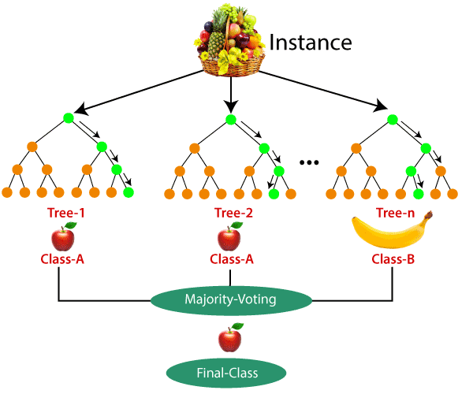
Example:
46

Slide 47
Example:
Suppose there is a dataset that contains multiple fruit images.
So, this dataset is given to the Random forest classifier.
The dataset is divided into subsets and given to each decision tree.
During the training phase, each decision tree
produces a prediction result.
And when a new data point occurs, then based on the majority of results, the Random Forest classifier predicts
the final decision.
47

Slide 48
Advantages of the Random Forest:
Random Forest is capable of performing both Classification and
Regression tasks.
It is capable of handling large datasets with high dimensionality.
It enhances the accuracy of the model and prevents the overfitting issue.
48

Slide 49
Disadvantages of the Random Forest:
Although Random Forest can be used for both classification and
regression tasks, it is not more suitable for Regression tasks.
49

Slide 50
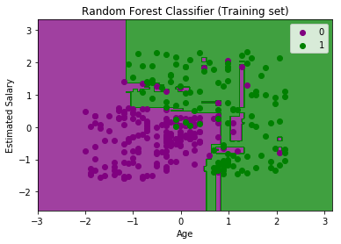
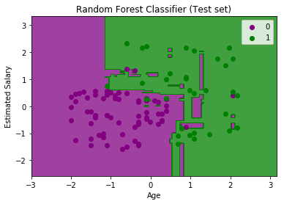
Sklearn Random Forest:
50

